Slide 1




North Carolina
4-H
Presentations
Presented by:
Dr. Shannon B. McCollum
4-H Youth Development Specialist, Extension Associate NC State Extension

Slide 2




Slide 3
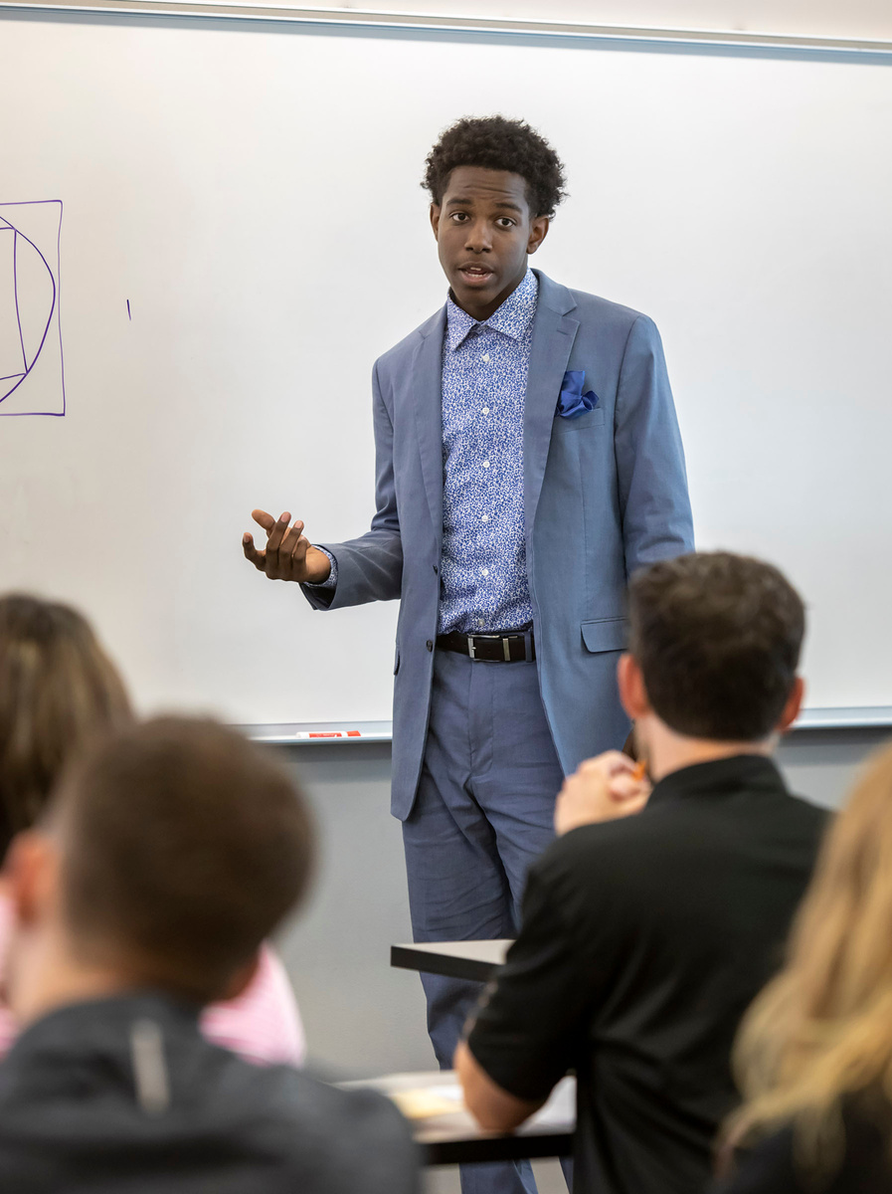
What are 4-H Presentations?
  A presentation is a way to share information with others, to teach what you know or have learned.
  While there are many types of presentations, 4-H materials concentrate on three areas: demonstrations, formal speech or illustrated talks.
  The Public Presentation Program is one of 4-H’s most beneficial and rewarding experiences.
  It is the one most often credited by 4-H alumni as having given them an edge above peers in both college and professional careers.
  It provides a unique opportunity to develop a positive self-concept and poise, gain self-confidence before a group, learn to express ideas clearly, respond spontaneously to questions, and gain subject matter knowledge.

Slide 4


Types of Presentations
Demonstrations
DOING, SHOWING HOW, MAKING – has a finished product to show - shows how a task is completed or product is made. For example: show how to make a healthy snack using fruits and vegetables.
Formal Speech
SHARES INFORMATION on a specific topic without using any visuals, props or materials. Sometimes this is a speech that a young person has memorized or a paper someone has written on a specific topic.
1
3
Illustrated Talk
TALKING, TELLING HOW, using CHARTS, PICTURES, MODELS - shares information with the help of pictures, video’s, charts, models etc.
2

Slide 5

Presentations
  Form of public speaking
    Communicate information
    Share ideas
    Share experiences
  Related to a specific project
  Demonstrations
  Illustrated talks
  Formal Speech
Notes:
In 4-H, presentations refer to a form of public speaking where 4-H members communicate information, ideas, or experiences related to their 4-H projects. These presentations can take various forms, including demonstrations, illustrated talks, public speeches, and more. The primary goal of 4-H presentations is to develop the public speaking and communication skills of youth while allowing them to share their knowledge and experiences with others.

Slide 6
Participating in Presentations
Goal is to develop public speaking skills and communication skills
  Help youth develop effective communication skills
  Allow them to become: confident, articulate, and knowledgeable
Notes:
Participating in 4-H presentations not only helps youth develop effective communication skills but also allows them to become confident, articulate, and knowledgeable advocates for the projects they are involved in. These presentations often take place at local, regional, and state 4-H events, providing members with opportunities to showcase their achievements and connect with a wider audience.

Slide 7
Why Public Speaking?
Self-Confidence
  Public speaking boosts self-confidence. As youth gain experience speaking in public, they become more comfortable expressing themselves and handling challenging situations, contributing to a positive self-image.
1
Effective Communications
  Public speaking is a fundamental aspect of effective communication. Youth who develop public speaking skills can express themselves clearly, share their ideas, and communicate with confidence.
3
2
Leadership Development
  Public speaking is a key leadership skill. Youth who can articulate their thoughts and ideas are more likely to take on leadership roles, whether in school, community, or future professional settings.
4
Advocacy & Persuasion
  Public speaking enables youth to advocate for themselves and others. They learn to present arguments persuasively and articulate their opinions, fostering skills that are valuable in academic, professional, and civic contexts.

Slide 8
Why Public Speaking?
Networking and Relationship Building
  Public speaking provides opportunities for networking and building relationships. Youth who can confidently express themselves are more likely to connect with peers, mentors, and potential collaborators.
5
Career Advancement
  In many professions, effective communication is a critical skill. Youth who develop strong public speaking skills gain a competitive edge in their future careers, as they can present ideas, lead meetings, and engage with diverse audiences.
7
6
Community Engagement
  Public speaking skills empower youth to actively participate in their communities. Whether addressing local issues or contributing to community projects, effective communication is essential for making a positive impact.

Slide 9
How do you teach public speaking skills?
Build Confidence
  Start with activities that help build confidence, such as icebreakers and small group discussions.
Practice Regularly
  Public speaking is a skill that improves with practice.
  Create opportunities for 4-H professionals to practice speaking in various settings.

Slide 10
How do you teach public speaking skills?
Provide Constructive Feedback
  Offer constructive feedback on both content and delivery.
  Encourage self-reflection and improvement.
Focus on Structure
  Teach the importance of a well-structured speech, including a clear introduction, body, and conclusion.
  Highlight the significance of engaging the audience from the beginning.

Slide 11
How do you teach public speaking skills?
Utilize Visual Aids
  Train on how to effectively use visual aids, such as slides or props.
  Emphasize that visuals should enhance, not distract from, the message.
Encourage Authenticity
  Encouraging authenticity in public speaking is crucial for creating genuine connections with the audience and establishing credibility.
  By encouraging authenticity in public speaking, 4-H professionals can help youth develop a communication style that is not only effective but also genuine and impactful. This skill not only serves them well in 4-H activities but also in various aspects of their personal and professional lives.

Slide 12



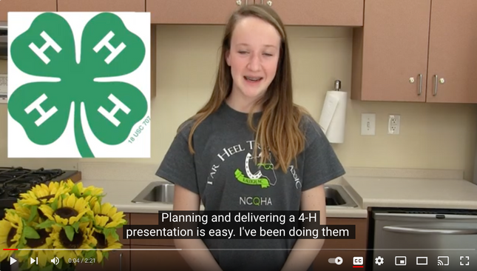
How to Video!
Notes:
https://youtu.be/ZxDM9VcpzBU
https://www.youtube.com/watch?v=p8jlsnKktk0
Sample Presentations - 2020
https://docs.google.com/spreadsheets/d/1iUXFMYaEAvCui8Nd1hMGBVfCWWcy9vHCUMoCjGrbu3k/edit#gid=1292410311

Slide 13
Getting Started
Notes:
How do you help a 4-H'er get ready to do a presentation? I'm going to hit the highlights on what you can start with to help them begin.
https://nc4h.ces.ncsu.edu/youth-3/4-h-awards-incentives-programs-2/presentations/
First - show them the resources that we have available - be familiar with them yourself.

Slide 14
Getting Started!
  Choose a topic
  Once the topic is selected, 4-H’er should find facts about their topic.
  Make sure that the sources are credible.
  Use a variety of materials:
    4-H Curriculum Manuals
    Books
    Internet - credible sources
    Personal Interviews
    Journal Articles
    Others.
  Bottom line - Research the topic.
Notes:
In 4-H, presentations refer to a form of public speaking where 4-H members communicate information, ideas, or experiences related to their 4-H projects. These presentations can take various forms, including demonstrations, illustrated talks, public speeches, and more. The primary goal of 4-H presentations is to develop the public speaking and communication skills of youth while allowing them to share their knowledge and experiences with others.

Slide 15
Getting Started!
  Keep track of the sources that are used
  Write down the:
    Name of the source
    Web address
    Page Numbers
    Author(s)
  Decide if this will be a
    Demonstration
    Illustrated Talk
    Formal Speech (Public Speaking Category)
Notes:
In 4-H, presentations refer to a form of public speaking where 4-H members communicate information, ideas, or experiences related to their 4-H projects. These presentations can take various forms, including demonstrations, illustrated talks, public speeches, and more. The primary goal of 4-H presentations is to develop the public speaking and communication skills of youth while allowing them to share their knowledge and experiences with others.

Slide 16
Creating the Presentation
  Create a catchy title
  Create an outline with your ideas.
  Write the way you talk!
  If it doesn’t make sense to you, it won’t make sense to them!!!
  Be clear!
  Preparation and Practice!
  An outline DOES NOT have to include every word of your speech.
  You are allowed to use note cards if it helps as you speak. But the more you practice, the less you’ll need them.
Notes:
In 4-H, presentations refer to a form of public speaking where 4-H members communicate information, ideas, or experiences related to their 4-H projects. These presentations can take various forms, including demonstrations, illustrated talks, public speeches, and more. The primary goal of 4-H presentations is to develop the public speaking and communication skills of youth while allowing them to share their knowledge and experiences with others.

Slide 17
Creating the Presentation
  Props (no live animals or weapons)
  Posters
  A tri-fold presentation poster board
  A digital slide presentation/PowerPoint
  Note cards
  Printed pictures or other props to demonstrate or teach with
Notes:
In 4-H, presentations refer to a form of public speaking where 4-H members communicate information, ideas, or experiences related to their 4-H projects. These presentations can take various forms, including demonstrations, illustrated talks, public speeches, and more. The primary goal of 4-H presentations is to develop the public speaking and communication skills of youth while allowing them to share their knowledge and experiences with others.

Slide 18
Parts of a Presentation
  Introduction- Grab the attention of the audience. Should be about 30 seconds to a minute. You can include a personal story here, a joke, an interesting fact, etc. Use this time to catch the judge’s attention and make them want to listen to what you have to say.
  Body- Includes the main points of your speech. Arrange them in logical order. Spend the majority of your speech here. Typically include about 3 main points or topics in your body section.
  Conclusion- Summarize your main points. Should be about 30 seconds to a minute. Review quickly what you told them and then challenge to learn more.
  Include References at the end
Notes:
In 4-H, presentations refer to a form of public speaking where 4-H members communicate information, ideas, or experiences related to their 4-H projects. These presentations can take various forms, including demonstrations, illustrated talks, public speeches, and more. The primary goal of 4-H presentations is to develop the public speaking and communication skills of youth while allowing them to share their knowledge and experiences with others.

Slide 19
4-H Agent Expectations

Slide 20
County 4-H Programs should...
  Be familiar with the resources we provide.
https://nc4h.ces.ncsu.edu/youth-3/4-h-awards-incentives-programs-2/presentations/
  Develop a county presentation program that will provide the opportunity for youth to participate in presentations on the county, district and state level.
  Offer a County Activity Day where youth can share their presentation in front of judges – mimic District Activity Day (or something similar) and provide a county level critique/feedback
  Be at District Activity Day with your youth who are presenting.
  Register for District & State Presentation competitions as requested.

Slide 21
How to help 4-H’ers get started?
  It starts with you as the professional!
  Be familiar with our resource materials:
    https://nc4h.ces.ncsu.edu/youth-3/4-h-awards-incentives-programs-2/presentations/
  To give a good presentation there are several steps that should be taken.
  Planning
  Preparation
  Presentation
  Poise (Appearance)
  Practice
Notes:
In 4-H, presentations refer to a form of public speaking where 4-H members communicate information, ideas, or experiences related to their 4-H projects. These presentations can take various forms, including demonstrations, illustrated talks, public speeches, and more. The primary goal of 4-H presentations is to develop the public speaking and communication skills of youth while allowing them to share their knowledge and experiences with others.

Slide 22
How to help 4-H’ers get started?
  Share the Presentation 101 Handbook with your 4-H’ers
    Presentation 101 Handbook - under Helpful Tools
  Picking a Topic!
    Choose a topic that interested them.
    Choose a topic that they know something about.
    Choose a topic that would be interesting to the audience.
  What category does their topic fit in?
    Presentation Categories
Notes:
In 4-H, presentations refer to a form of public speaking where 4-H members communicate information, ideas, or experiences related to their 4-H projects. These presentations can take various forms, including demonstrations, illustrated talks, public speeches, and more. The primary goal of 4-H presentations is to develop the public speaking and communication skills of youth while allowing them to share their knowledge and experiences with others.

Slide 23
Rules & Regulations

Slide 24
Age Categories - Age as of Jan. 1
All youth must be registered and approved in 4-HOnline
5-7 CloverBud - do not compete in the ranking as Gold, Silver, Bronze. Can present at County and District level only
8-10 - Compete at County, District and State Level
11-13 - Compete at County, District and State Level
14-18 - Compete at County, District and State Level
Notes:
In 4-H, presentations refer to a form of public speaking where 4-H members communicate information, ideas, or experiences related to their 4-H projects. These presentations can take various forms, including demonstrations, illustrated talks, public speeches, and more. The primary goal of 4-H presentations is to develop the public speaking and communication skills of youth while allowing them to share their knowledge and experiences with others.

Slide 25
Rules & Guidelines
  Age eligibility is established on January 1st of the current year.
  To participate in a Presentation competition, the youth must be eight years of age on January 1st of the current year and not have had his/her 19th birthday before January 1st of the current year.
  Youth must be present to compete.
Notes:
In 4-H, presentations refer to a form of public speaking where 4-H members communicate information, ideas, or experiences related to their 4-H projects. These presentations can take various forms, including demonstrations, illustrated talks, public speeches, and more. The primary goal of 4-H presentations is to develop the public speaking and communication skills of youth while allowing them to share their knowledge and experiences with others.

Slide 26
Time Limits
  Identified in the 4-H Awards Handbook (Pages 12 – 13)
    5 minutes minimum and a maximum of 12 minutes.
    Exceptions are as follows:
    Public Speaking (5-7 minutes);
    Chicken Barbecue (2 hours); Turkey Barbecue (2 hours); Pork Cookery (2 hours); Beef Char-Grill (2 hours); Seafood (2 hours)
    Horse - outlined on next slide
Time limits will play a role in ranking presentations, so stress the importance of staying within the limits.

Slide 27
Horse Time Limits
  Horse, Individual 8-10, 11-13: 4-12 minutes
  Horse, Individual 14-18: 9-12 minutes
  Horse, Team 8-10, 11-13: 5-15 minutes
  Horse, Team 14-18: 10-15 minutes
  Horse Public Speaking 8-10, 11-13: 4-10 minutes
  Horse Public Speaking, 14-18: 8-10 minutes.
    One point is deducted per judge for each minute under or over time limits.

Slide 28
Rules & Guidelines
  Each county may enter two presentations per age division category.
  4-H members may compete in no more than one presentation program per year at the district and state levels. This means they cannot do outdoor cookery and a presentation.
  4-H Entertains is excluded – they can do both.
  8-10, 11-13 & 14-18 district “GOLD & SILVER” medal winners are eligible to participate in the state competition

Slide 29
Guidelines cont...
  4-H members may continue to compete in a particular presentation category until declared state GOLD Medal winner in that age division.
  A GOLD medal presentation may not be presented again in the same age category
  Individuals or Team can compete in presentations but they compete against each other in same category.
  35 presentation categories.

Slide 30
Guidelines cont...
  In all levels of the the Competitive Presentation program - a team is composed of only two individuals.
  If the team giving a presentation is composed of individuals in two different age divisions (8-10, 11-13, 14-18), the team must compete in the older youth’s age division.
  Open Class: Only presentations that do not fit into any other subject-matter category are allowed in this area.
  Presentation Setup: The speaker is responsible for setting up all equipment for the presentation. If there are issues with the technology – the PIC can help with this.

Slide 31
Guidelines cont...
  Interruptions: The judges will determine if the participant should begin where they left off or start anew.
  Note cards: The speaker is allowed to use note cards but, they should be used as a tool for referencing material (the speaker should not read directly from their cards). Should be kept to a minimum
  Youth may opt to repeat the question, paraphrase the question or include the question in their answer but this is NOT a requirement.
  Youth have given an acceptable response when they admit you they are unable to answer the question.
  Attire for the Public Speaking category should be professional dress.
  Dressing for the presentation topic is appropriate.

Slide 32
Important Guidelines/Rules
  NO live animals / insects may be used in any presentation.
  NO real OR play handguns/ firearms / Weapons are not allowed to be used during presentations.
    NCGS 14-269.2 Class 1 Felony
    School Suspension
  NO swords, knives, bow & arrows sets, etc. Bow is fine with no arrow. Arrows are not ok.
  Presentations are given for the following Outdoor Cooking Categories in the 14-18 age categories
    Chicken Char-Grill
    Turkey Char-Grill
  Outdoor Cooking – all 8-10 & 11-13 year olds must have an adult who is responsible for them at District Day and State Presentation Finals.

Slide 33
Food Categories
  Food Categories
  All Foods Categories will be asked to demonstrate a mastery of preparation steps
  Note: each category has basic ingredient requirements. Check website for specifics.
  It’s a good idea to cook all items before coming to DAD or State Finals due to limitations at the sites.
  All presenters are required to “demonstrate” however depth of knowledge is stressed not taste.
  Due to limitations at District and State, youth should cook their final product prior to arriving for competition.

Slide 34
Use of Electronics
  We are asking each PIC to provide a LCD projector and a laptop but encourage agents to bring one back up.
  All set up of presentation materials is also the responsibility of the participant. However if there are issues with the equipment, they can ask for help of the PIC in the room.
  A presentation using electronics such as powerpoint etc should NOT carry more weight than those who do not use them.
  Internet is not an option at DAD. Bring a copy on a flash drive of their presentation.

Slide 35
Awards

Slide 36

Awards
  A County Winner ribbon is given to each participant.
  A medal is awarded to the Gold, Silver and Bronze district winners.
  One presentation in each category age division will be designated as the district gold winner
  District Gold and Silver Winners are eligible to move to the State competition during State Presentation Finals

Slide 37
4-H Entertains

Slide 38
4-H Entertains
  Showcase of Talent
  Selection process for 4-H’ers to be asked to share their talent at events throughout the year.
  Each county is limited to two (2) "4-H Entertains" Acts at their DAD.
  5 minutes per act total. If only one act - it can only be 5 minutes.
  Not a competition – a Showcase of Talent

Slide 39
Guidelines
  4-H’ers age 8-18 as of January 1
  Talent acts can be individual or group
  Should appeal to a youth audience
  Talent acts can be dance, dramatic, variety, instrumental or vocal
  Maximum of five minutes per act
  Animal acts, use of fire or groups requiring excessive setup time are not allowed

Slide 40
Recognition of Talent
  Blue ribbons to quality acts
  Select 2-3 talent acts to perform at awards assembly. These may or may not be the ones recommended for the Talent Show at Congress.
  Recommend the 2-3 best talent acts for 4-H Congress
  This is ONLY a recommendation. Never promise a talent act they will be performing at 4-H Congress.
  Video Recording of District Talent Acts - sent to state for selections process

Slide 41
Recognition of Talent
  One of the most important responsibilities of the PIC for the DAD talent program is to videotape each talent act and give the video to State 4-H Staff Person on site along with copies of the judges sheets and comments.
  Host County will provide the following:
  Piano or full-size keyboard
  Sound system with multiple microphones
  Ability to play CDs or digital audio files

Slide 42
Judging Criteria - Entertains
  Audience appeal
  Projection
  Appropriate dress or costume
  Poise
  Staging and/or movement on stage
  Skills in areas of presentation (talent)

Slide 43
District Activity Day
(DAD)

Slide 44
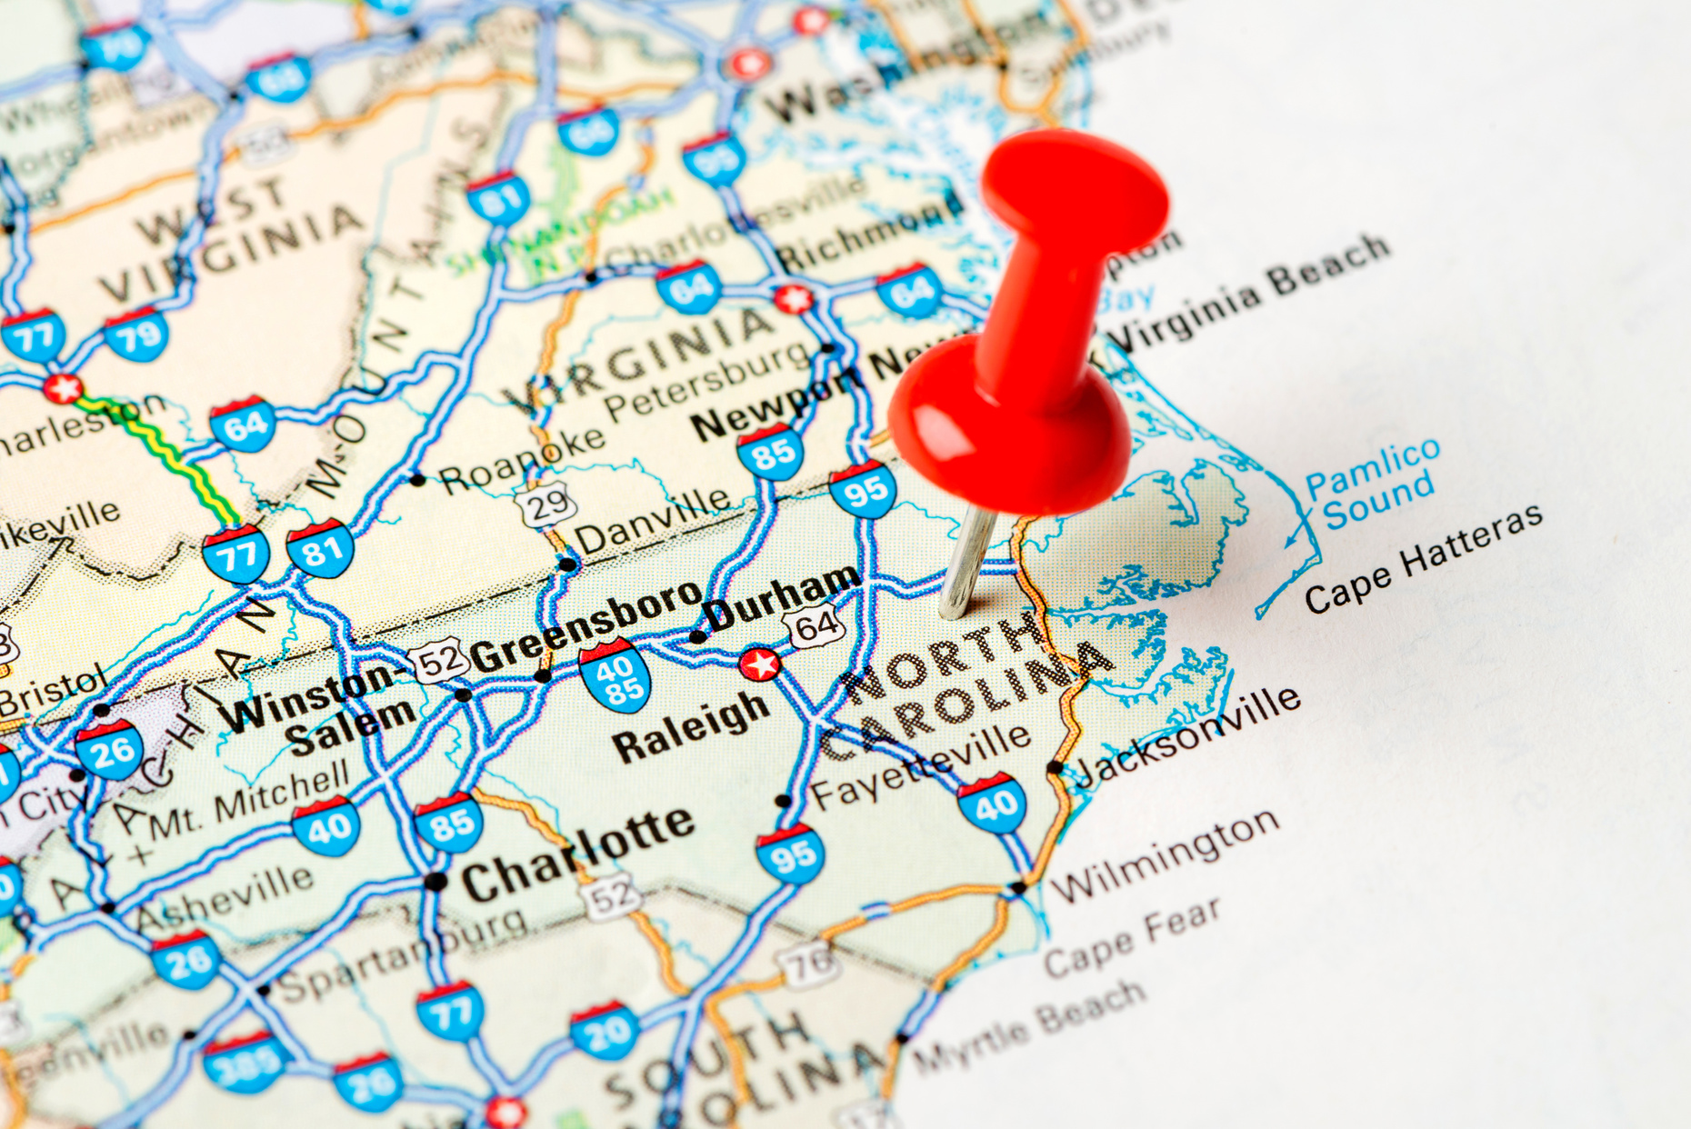
DAD Dates
  June 14 - SE - Wayne, Johnston, Wilson - University of Mount Olive
  June 14 - West - Swain, Transylvania, Watauga - WCU
  June 15 - NC - Alamance, ​​Chatham and Durham - NC A&T
  June - 18 - SC - Scotland - Scotland High School
  June 21 - NE - Bertie & Edgecombe - Edgecombe Community College
  Registration Deadline is May 24, 2024

Slide 45
DAD Onsite
  Host County/State 4-H Specialist will share the specific details with their District 4-H Agent group.
  DAD - Host County will contact each 4-H Agent in their district with lunch plans, directions and other specific information.
  Room assignments will be made no earlier than a week out due to constant changes.

Slide 46
DAD Onsite
  PIC – each room has a Person In Charge that has been assigned by the District Director’s Office
  PIC’S bring 3 judges, easel and a laptop, lcd projector
  Room Host – each room will have a room host volunteer. Host County will provide.

Slide 47
Day of Duties
  Arrive and report to registration desk to pick up room assignments, meal tickets and any other materials as needed.
  Make sure 4-H’ers are reporting to appropriate rooms: sign up on outside of doors for room order.
  Report to Award Processing room for: drop/change forms, attendance forms, pick up record books, drop off scrapbooks – depends on District.
  Check on 4-H’ers
  Lunch
  Awards Assembly
  Pick up Score sheets, project & portfolios at end of assembly as you leave – review before giving back to 4-H’ers.

Slide 48
Schedule/Agenda
8:00 am State 4-H Staff arrive on site
9:00 - 10:00 Registration – Host County
9:30 - Judges Orientation with Person’s In Charge (All Agents serving as PIC’s and judges)
10:30 - Presentations Begin
12:00 - 1:30: Lunch

Slide 49
Schedule/Agenda
1:45 – 3:30: Afternoon Awards Program
Welcome - District Officers
Pledges - District Officers
Thought for the Day - District Officers
Introduction of Guest - District Officers
Greetings - arranged by host county - introduced by District Officers
Special Recognition - Agent Advisors - recognize outgoing District Officers, introduce incoming District Officers.
Presentation of Awards - District Officers (read script and assist with awards), State 4-H Program Leader if he’s there, DED, Extension Administration (Shake hands and present awards)

Slide 50
State Presentations

Slide 51
State Presentation Finals
  District Gold & Silver Winners in all 3 age groups move on to State Finals
  Youth compete in 4-H Presentations for State Awards: Gold, Silver & Bronze
  Youth participate in 3 age categories: 8-10, 11-13, & 14-18
  35 Categories ( Cloverbuds do not compete at State Finals)
  More Information will be sent out in May
    Meal Tickets
    T-Shirt Order
    Directions
    Outdoor Cookery Location
    Registration

Slide 52
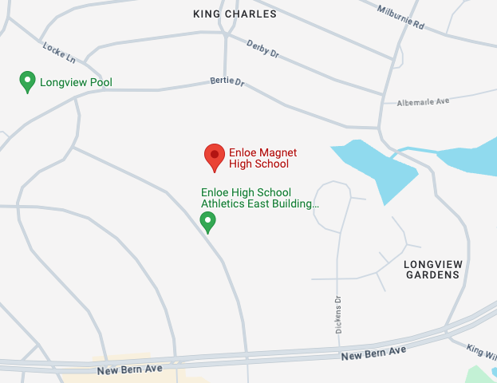

State Presentation Finals
  July 23, 2024
  Enloe High School - Presentations
  Outdoor Cookery - TBD
  Registration Deadline - June 26, 2024 Noon
128 Clarendon Crescent
Raleigh, NC 27610

Slide 53
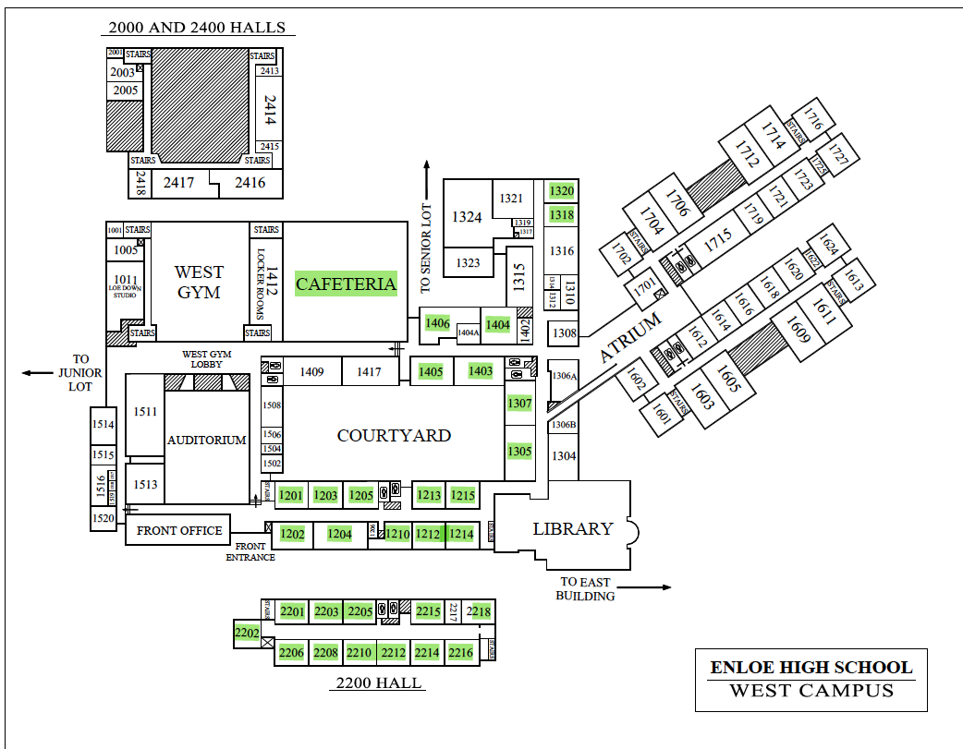
Enloe High School

Slide 54
Schedule/Agenda
Presentations
7:30 am - Information Desk opens in Main Building. To pick up pre-ordered meal tickets and pre-ordered t-shirts go 4-H Information Desk. We will have those available at 9:30 am.
7:45 am - 8:00 am – Judges and PIC’s Arrive. PIC packets not already picked up will be in the registration desk.
8:30 am – 4:30 pm – Presentation Competition
8:30 am - Please report directly to assigned Presentation room found on the reverse side of this handout. Presentations begin with 14-18, then move 11-13, then move to 8-10. Depending on the participation numbers, some categories may want to start earlier but we will communicate as soon as we know.
11:00 am – 1:00 pm – Lunch for pre-orders. Must have lunch tickets.
12:00 Noon - 4:30 pm – Presentations - 8-10 Age Division Competitions.

Slide 55
Schedule/Agenda
Outdoor Cookery
7:30 am - Registration to pick up pre-ordered meal tickets and pre-ordered t-shirts: Main Registration Desk for Outdoor Cookery - Location TBD
7:30 am – 8:15 am – Arrival and set up Grills in designated areas
8:30 am – Outdoor Cooking competition begins: Turkey, Chicken, Seafood, Pork and Beef Char-Grill – all age divisions. Person In Charge will announce when everyone can start their grills.
11:00 am – 1:00 pm – Lunch for pre-orders. Must have lunch tickets.

Slide 56

Registration Process
  Register each participant in 4-HOnline for District and State Presentations.
  Will open April 15 for DAD
  Will open on June 14 for State Presentation Finals

Slide 57
American Income Life
I have taken out American Income Life insurance to cover all District Activity Day’s & State Finals.
The Policy Number and information is below:
Serial Number: 2403-1408-49260 Policy Number: 718C Group Name: NC 4-H Presentations
Should you need it – print the claim form here:
http://www.americanincomelife.com/

Slide 58
Resources
  https://nc4h.ces.ncsu.edu/youth-3/4-h-awards-incentives-programs-2/presentations/
  Presentation Sample Videos:
    How to do a Presentation
    Sample Presentation Videos - pre-recorded
    Sample Horse Public Speaking

Slide 59

Thank
You

